Slide 1
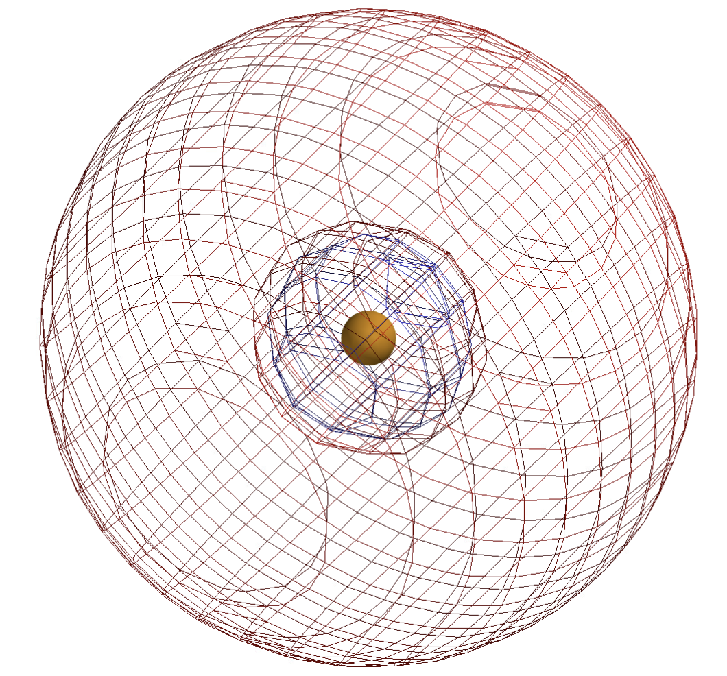
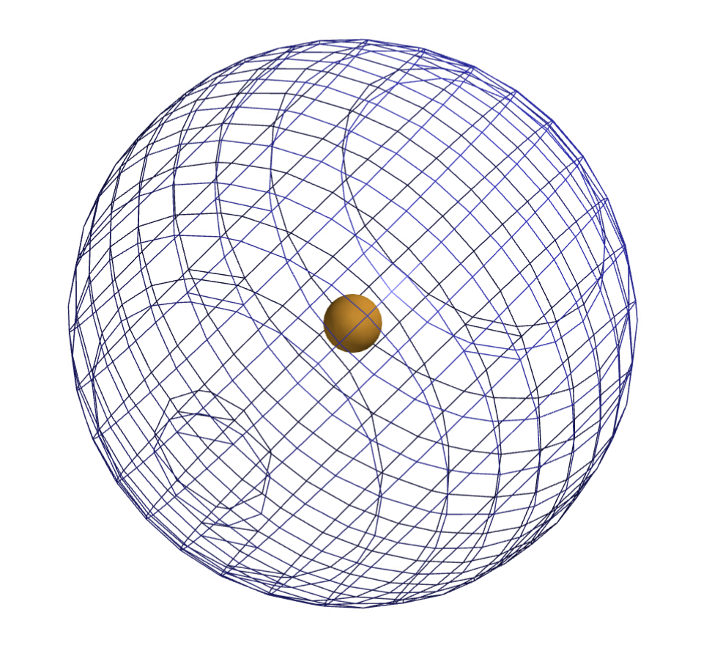
Last time: 1st and 2nd shells of Helium
s-orbital comprising the 1st shell, containing two electrons
Spartan labels this HOMO (for Highest Occupied Molecular Orbital)
Empty s-orbital in the 2nd shell
Spartan labels this LUMO (for Lowest Unoccupied Molecular Orbital)

Slide 2
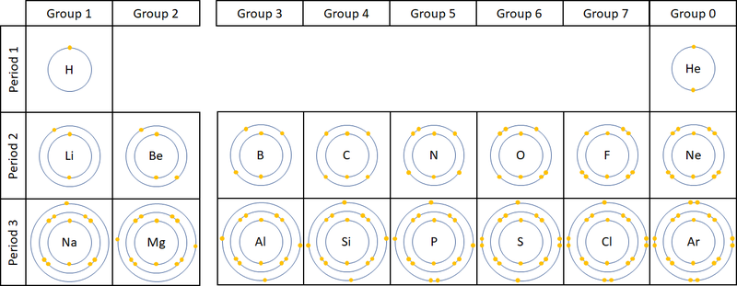
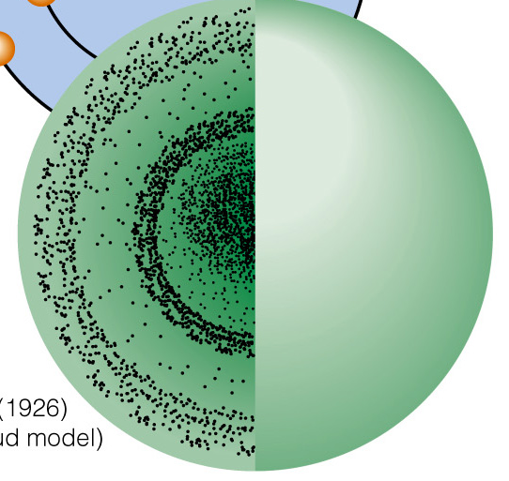
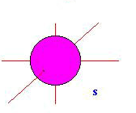
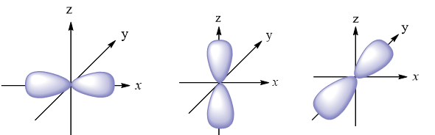
2nd shell actually has four orbitals altogether
s orbital
p orbitals

Slide 3
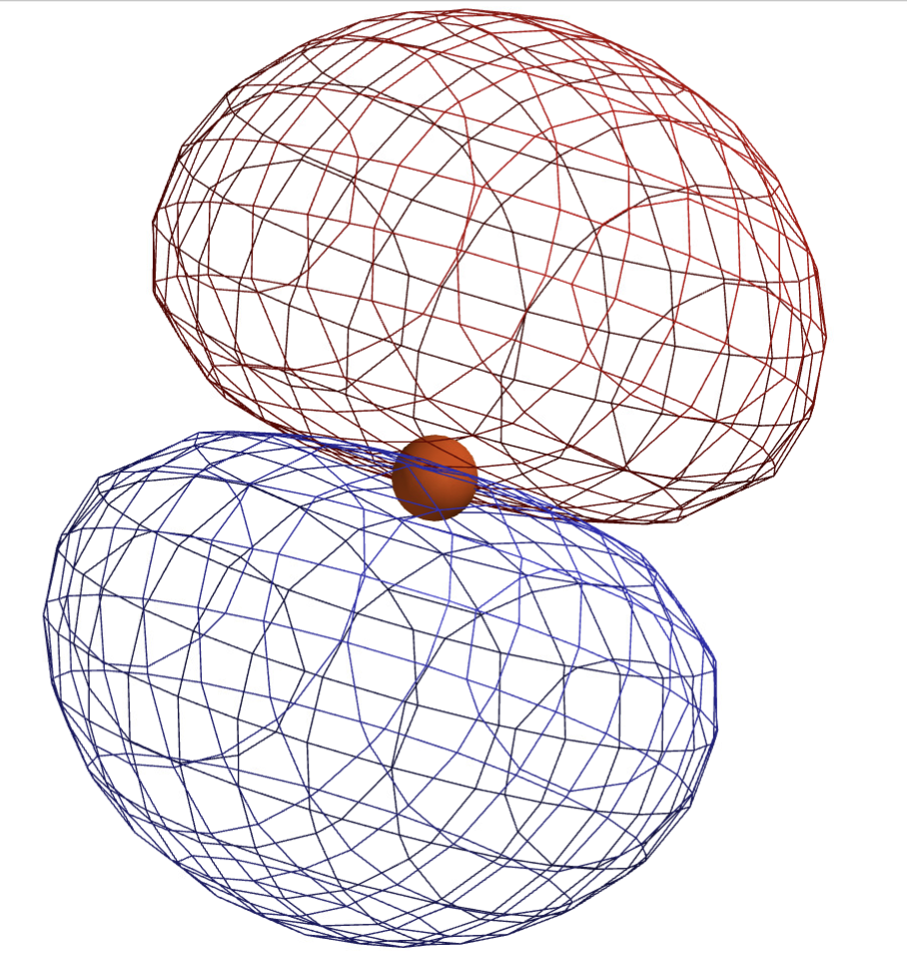
A closer look at the orbitals of the 2nd shell
s-orbital in the 2nd shell
One of three p-orbitals in the 2nd shell

Slide 4
Motions associated with these orbitals?
s-orbital in the 2nd shell
Notice the radial node
One of three p-orbitals in the 2nd shell

Slide 5
Motions associated with these orbitals?
s-orbital in the 2nd shell
Notice the radial node
In-and-out breathing motion
One of three p-orbitals in the 2nd shell

Slide 6
Motions associated with these orbitals?
s-orbital in the 2nd shell
Notice the radial node
In-and-out breathing motion
One of three p-orbitals in the 2nd shell
Notice the planar node

Slide 7
Motions associated with these orbitals?
s-orbital in the 2nd shell
Notice the radial node
In-and-out breathing motion
One of three p-orbitals in the 2nd shell
Notice the planar node
These electrons have angular momentum!

Slide 8
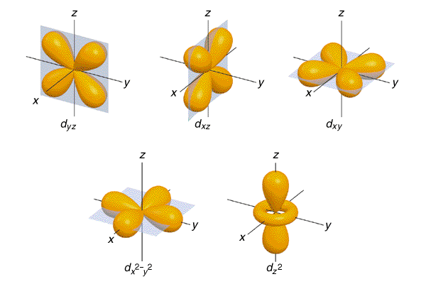
Orbitals that make up the 3rd shell: s, p, and d type
3nd shell has d-orbitals in addition to the s- and p-orbitals
(we’ll talk about those later)
s orbital
d orbitals
p orbitals

Slide 9
Pauli Exclusion Principle (PEP)
If there’s no electron, we call it an empty orbital
If there’s one electron, we call it a ½-filled orbital.
If there are two electrons, we call it a filled orbital.

Slide 10
Pauli Exclusion Principle (PEP)
If there’s no electron, we call it an empty orbital
If there’s one electron, we call it a ½-filled orbital.
If there are two electrons, we call it a filled orbital.
Electrons in the same orbital must be spin-paired, meaning they have opposite spins.

Slide 11
Pauli Exclusion Principle (PEP)
If there’s no electron, we call it an empty orbital
If there’s one electron, we call it a ½-filled orbital.
If there are two electrons, we call it a filled orbital.
Electrons in the same orbital must be spin-paired, meaning they have opposite spins.
These two requirements (maximum of two electrons, spin-paired) are the complete Pauli Exclusion Principle, or PEP.

Slide 12
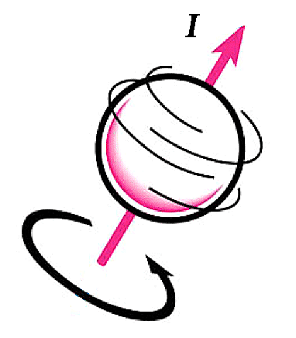
Pauli Exclusion Principle (PEP)
2 electrons in the same orbital, spin-paired. OK!
spinning in one direction
”Spin up”
spinning in the other direction
“Spin down”

Slide 13
Pauli Exclusion Principle (PEP)
2 electrons in the same orbital, spin-paired. OK!
This doesn’t happen
spinning in one direction
”Spin up”
spinning in the other direction
“Spin down”

Slide 14
Pauli Exclusion Principle (PEP)
2 electrons in the same orbital, spin-paired. OK!
This doesn’t happen
spinning in one direction
”Spin up”
spinning in the other direction
“Spin down”
Neither does this

Slide 15
Pauli Exclusion Principle (PEP)
2 electrons in the same orbital, spin-paired. OK!
This doesn’t happen
spinning in one direction
”Spin up”
spinning in the other direction
“Spin down”
Neither does this
Neither does this

Slide 16
How shells and orbitals explain row 1 of the Periodic Table
1st shell has one orbital (called an s-orbital)

Slide 17
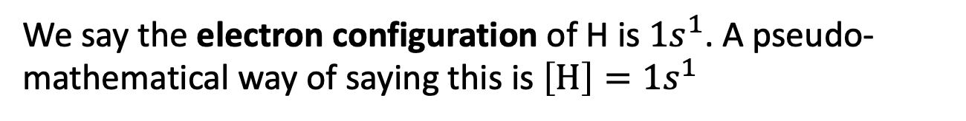
How shells and orbitals explain row 1 of the Periodic Table
1st shell has one orbital (called an s-orbital)
We say the electron configuration of H is $1s^{1}$. A pseudo-mathematical way of saying this is $\left[H\right]=1s^{1}$

Slide 18
How shells and orbitals explain row 1 of the Periodic Table

Slide 19
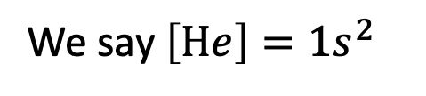
How shells and orbitals explain row 1 of the Periodic Table
We say $\left[He\right]=1s^{2}$

Slide 20


How shells and orbitals explain row 1 of the Periodic Table
$$\left[H\right]=1s^{1}$$
$$\left[He\right]=1s^{2}$$
Since the 1st shell has only one orbital, there are only two elements (hydrogen and helium) in the first row of the periodic table.

Slide 21
How shells and orbitals explain row 2 of the Periodic Table
1s orbital
1st shell (still) has one s-orbital, with two electrons. These are now called core electrons.
2nd shell’s four orbitals accommodate a maximum of eight electrons. These are called valence electrons.
Here’s Neon, with 10 electrons
2s orbital
2p orbitals

Slide 22
How shells and orbitals explain row 2 of the Periodic Table
That’s why there are eight elements (hydrogen and helium) in the first row of the periodic table
1s orbital
1st shell (still) has one s-orbital, with two electrons. These are now called core electrons.
2nd shell’s four orbitals accommodate a maximum of eight electrons. These are called valence electrons.
Here’s Neon, with 10 electrons
2s orbital
2p orbitals

Slide 23
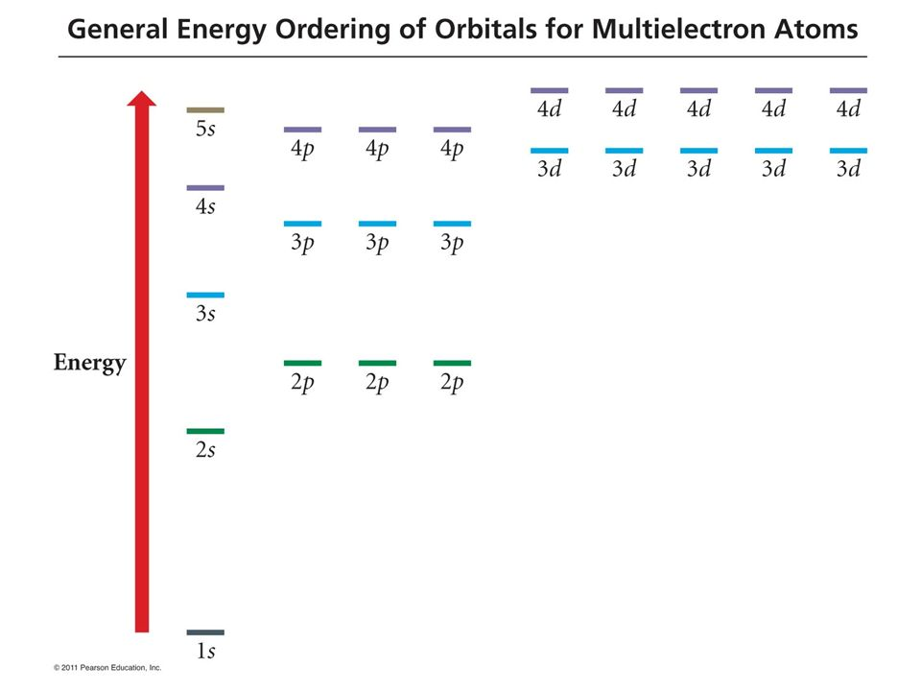
The General Energy Ordering of Orbitals (GEOO) diagram
3rd Shell
2nd Shell
1st Shell

Slide 24
Aufbau using the GEOO diagram
Aufbau is the (mental) process of assigning electrons to lowest available orbitals
1s

Slide 25
Electron configuration of H: $\left[H\right]=1s^{1}$
We’ve seen that $\left[H\right]=1s^{1}$
1s

Slide 26
Electron configuration of He: $\left[He\right]=1s^{2}$
And $\left[He\right]=1s^{2}$
1s

Slide 27
Electron configuration of Li
Lithium’s electron configuration is
1s² 2s¹
We also write this [He] 2s¹
2s
1s

Slide 28
Electron configuration of Li
Lithium’s electron configuration is
1s² 2s¹
We also write this [He] 2s¹
What’s next, aufbau?
2s
1s

Slide 29
Electron configuration of Be
Beryllium’s electron configuration is
1s² 2s²
(same as [He] 2s²)
What’s next, aufbau?
2s
1s

Slide 30
Electron configuration of B
Boron has
1s² 2s² 2p¹
(same as [He] 2s² 2p¹)
What’s next, aufbau?
2s orbital
2p orbitals

Slide 31
Electron configuration of C
Carbon has
1s² 2s² 2p²
But there’s an unexpected pattern here …
2s orbital
2p orbitals

Slide 32
Electron configuration of C
Carbon has
1s² 2s² 2p²
But there’s an unexpected pattern here …
2s orbital
2p orbitals

Slide 33
Electron configuration of C
Carbon has
1s² 2s² 2p²
But there’s an unexpected pattern here …
Hund’s Rule:
Split up as much as possible when energy is the same
2s orbital
2p orbitals

Slide 34
Electron configuration of N
Nitrogen has
1s² 2s² 2p³
Hund’s Rule:
Split up as much as possible when energy is the same
2s orbital
2p orbitals

Slide 35
Electron configuration of O
Oxygen has
1s² 2s² 2p⁴
[He] 2s² 2p⁴
Hund’s Rule:
Split up as much as possible when energy is the same
2s orbital
2p orbitals

Slide 36
Aufbau-ing up to Neon
To Ne
(10)
[N] = …
[O] = …
[F] = …
[Ne] = …

Slide 37
Aufbau-ing up to Neon
To Ne
(10)
[N] = [He] 2s²2p³
[O] = [He] 2s²2p⁴
[F] = [He] 2s²2p⁵
[Ne] = [He] 2s² 2p⁶

Slide 38
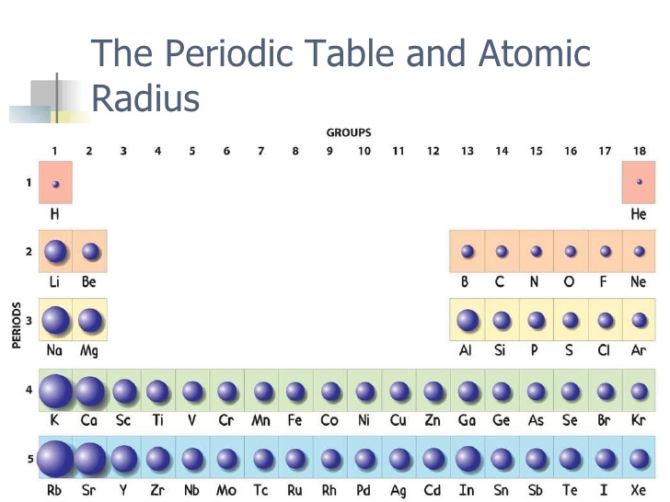
A reminder about the sizes of atoms

Slide 39
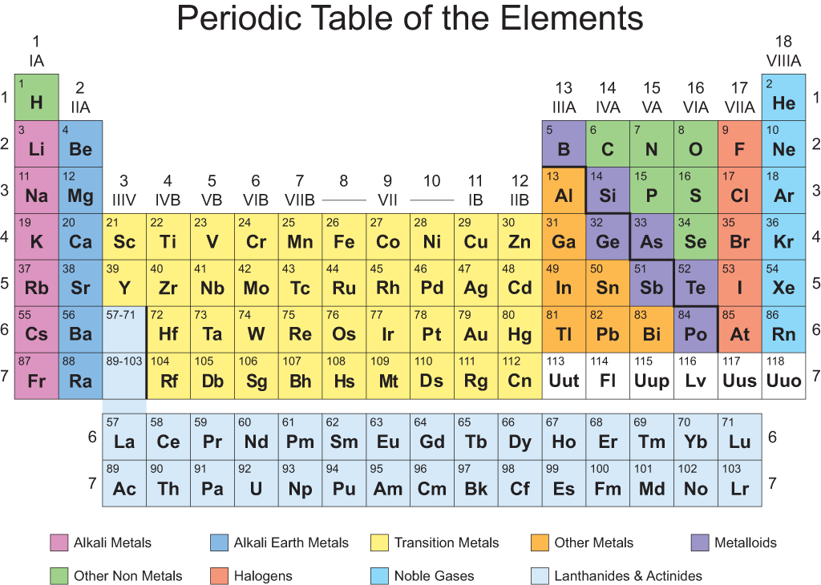
Aufbau-ing up to Sodium
[Na] = [Ne] 3s¹
To Na
(11)

Slide 40
Aufbau-ing up to Sodium
[Na] = [Ne] 3s¹
What’s next, aufbau?
To Na
(11)

Slide 41
Aufbau-ing up to Magnesium … Argon
[Na] = [Ne] 3s¹
[Mg] = [Ne] 3s²
[Al] =
[Si] =
[P] =
[S] =
[Cl] =
[Ar] =
To Mg
(12)

Slide 42
Aufbau-ing up to Magnesium … Argon
[Na] = [Ne] 3s¹
[Mg] = [Ne] 3s²
[Al] = [Ne] 3s²3p¹
[Si] =
[P] =
[S] =
[Cl] =
[Ar] =
To Al
(13)

Slide 43
Aufbau-ing up to Magnesium … Argon
[Na] = [Ne] 3s¹
[Mg] = [Ne] 3s²
[Al] = [Ne] 3s²3p¹
[Si] = [Ne] 3s²3p²
[P] = [Ne] 3s²3p³
[S] = [Ne] 3s²3p⁴
[Cl] = [Ne] 3s²3p⁵
[Ar] = [Ne] 3s²3p⁶

Slide 44
4s is next!
[K] =
[Ca] =

Slide 45
4s is next!
[K] = [Ar] 4s¹
[Ca] = [Ar] 4s²

Slide 46
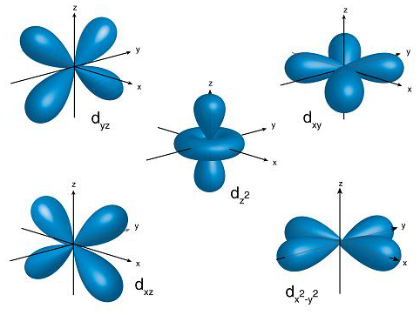
3d is next!
[Sc] = [Ar] 4s²3d¹
…
[Zn] = [Ar] 4s²3d¹⁰

